Slide 1



MCSE 666:Pattern and Speech Recognition
Learning
(Biological, Machine Learning, Regression, and Classification)
Dr. Md. Aminul Haque Akhand Dept. of CSE, SUB

Slide 2
Learning
2
Learning is the process of acquiring new or existing modifying
knowledge, behaviors, skills, values, or preferences
https://en.wikipedia.org/wiki/Learning
Learning is “a process that leads to change, which occurs as a result of experience and increases the potential for improved performance and future learning”
---(Ambrose et al, 2010, p.3).
“A change in human disposition or capability that persists over a period of time and is not simply ascribable to processes of growth.”
— From The Conditions of Learning by Robert Gagne

Slide 3
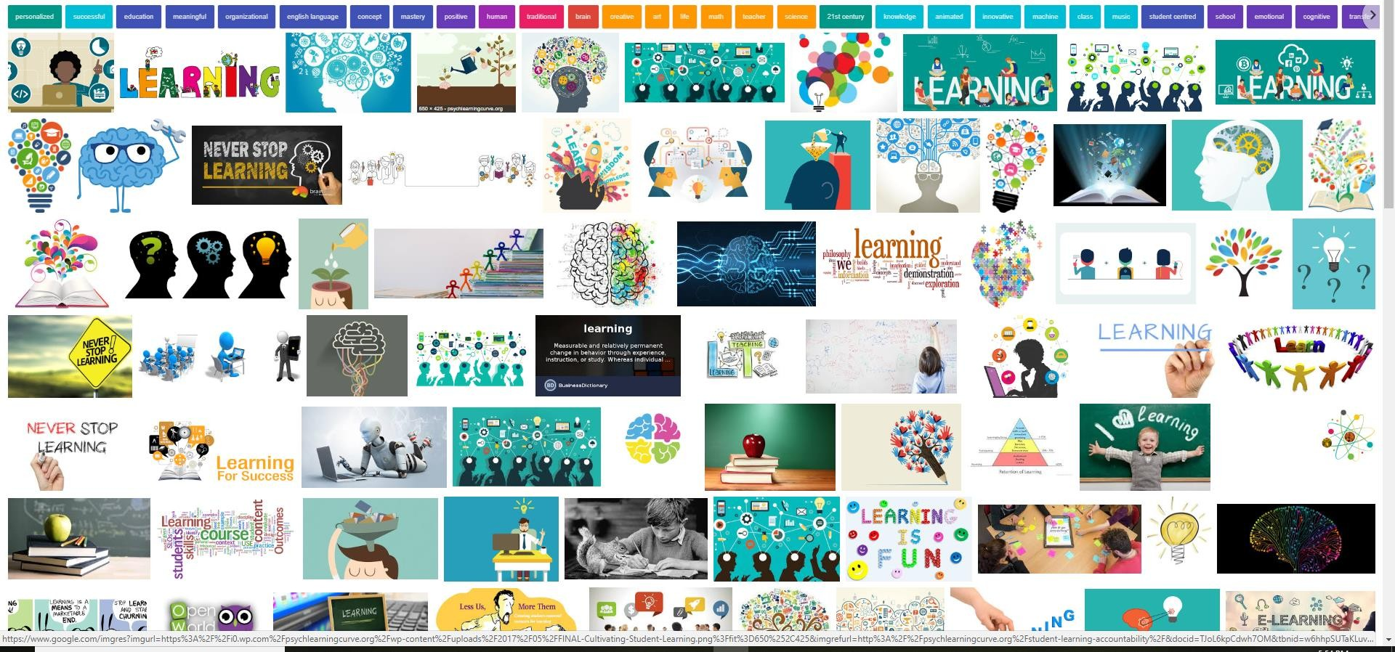
Learning
3
The change in the learner may happen at the level of knowledge, attitude, or behaviour. As a result of learning, learners come to see concepts, ideas, and/or the world differently.
Learning is not something done to students, but rather something students themselves do. It is the direct result of how students interpret and respond to their experiences. https://www.teachwithmrst.com/post/what-is-learning
Human brain is the main element of learning

Slide 4
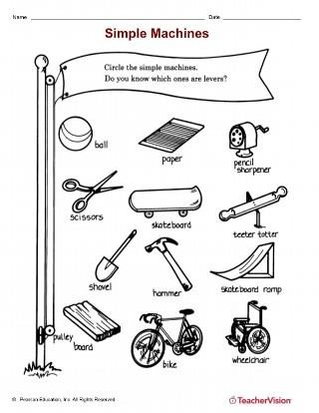
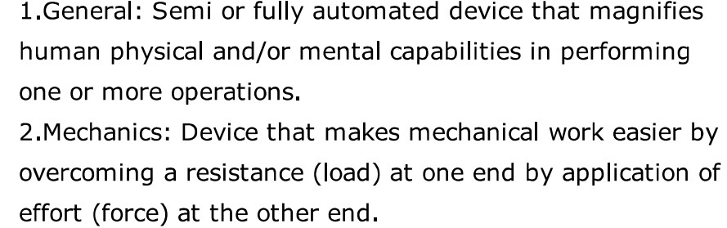
Machine
4
A machine is a physical system using power to apply forces and control movement to perform an action. … Machines can be driven by animals and people, by natural forces such as wind and water, and by chemical, thermal, or electrical power ...They can also include computers and sensors that monitor performance and plan movement, often called mechanical systems. https://en.wikipedia.org/wiki/Machine
An apparatus using or applying mechanical power and having several parts, each with a definite function and together performing a particular task. ‘a fax machine’
Oxford Dictionary

Slide 5
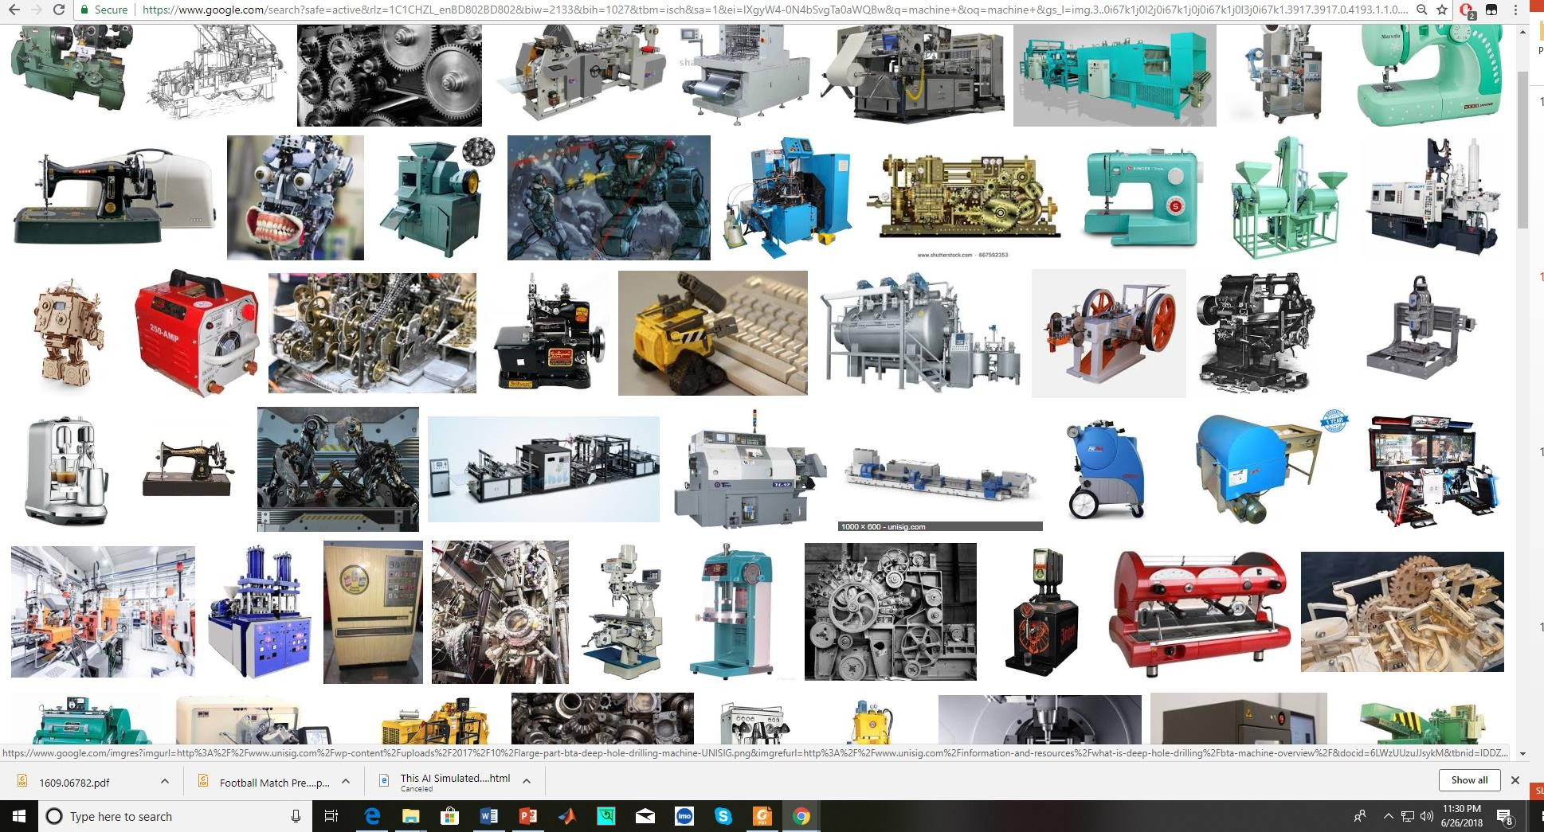
Machine
5
Machines include a system of mechanisms that shape the actuator input to achieve a specific application of output forces and movement.
How make decision to perform task(s)?

Slide 6
Machine Learning
6
In 1959, Arthur Samuel, a pioneer in the field of machine learning (ML) defined it as the “field of study that gives computers the ability to learn without being explicitly programmed”.
https://theconversation.com/what-is-machine-learning-76759
Machine learning (ML) is the study of computer algorithms that can improve automatically through experience and by the use of data.^{[1]} It is seen as a part of artificial intelligence. Machine learning algorithms build a model based on sample data, known as training data, in order to make predictions or decisions without being explicitly programmed to do so.^{[2]} Machine learning algorithms are used in a wide variety of applications, such as in medicine, email filtering, speech recognition, and computer vision, where it is difficult or unfeasible to develop conventional algorithms to perform the needed tasks.^{[3]}
https://en.wikipedia.org/wiki/Machine_learning

Slide 7
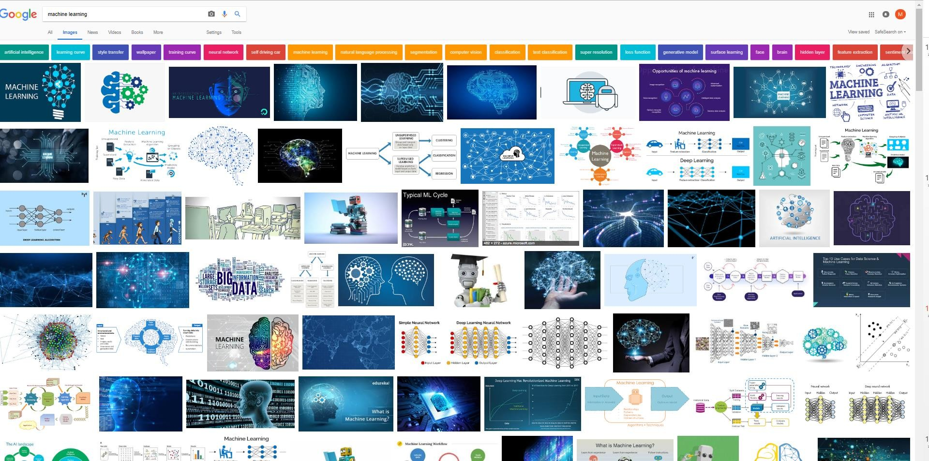
Machine Learning
7
Technique to give computer brain like learning ability through progressively update with data,
without being explicitly programmed.

Slide 8
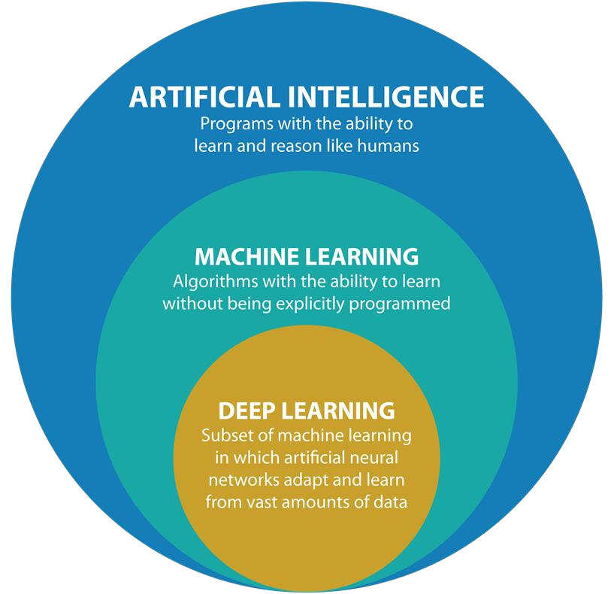
AI ->Machine Learning->Deep Learning
8
https://www.argility.com/argility-ecosystem-solutions/industry-4-0/machine-learning-deep-learning/

Slide 9
AI ->Machine Learning->Deep Learning
9
Artificial Intelligence (AI)
AI is the broadest term, applying to any technique that enables computers to mimic human intelligence, using logic, if-then rules, decision trees, and machine learning (including deep learning).
Machine Learning
The subset of AI that includes that enable machines to improve at tasks with experience. The category includes deep learning.
Deep Learning
The subset of machine learning composed of algorithms to train itself to perform tasks, like speech and image recognition, by exposing multilayered neural networks to vast amounts of data.

Slide 10
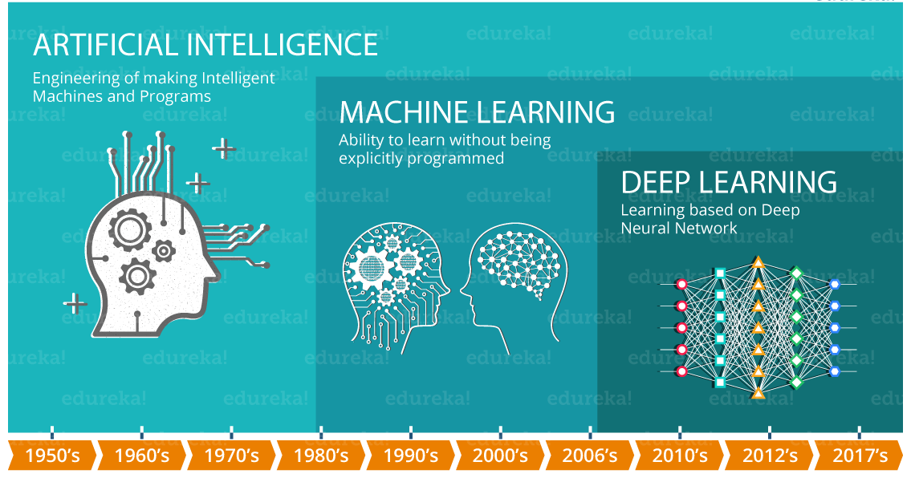
AI ->Machine Learning->Deep Learning
11

Slide 11
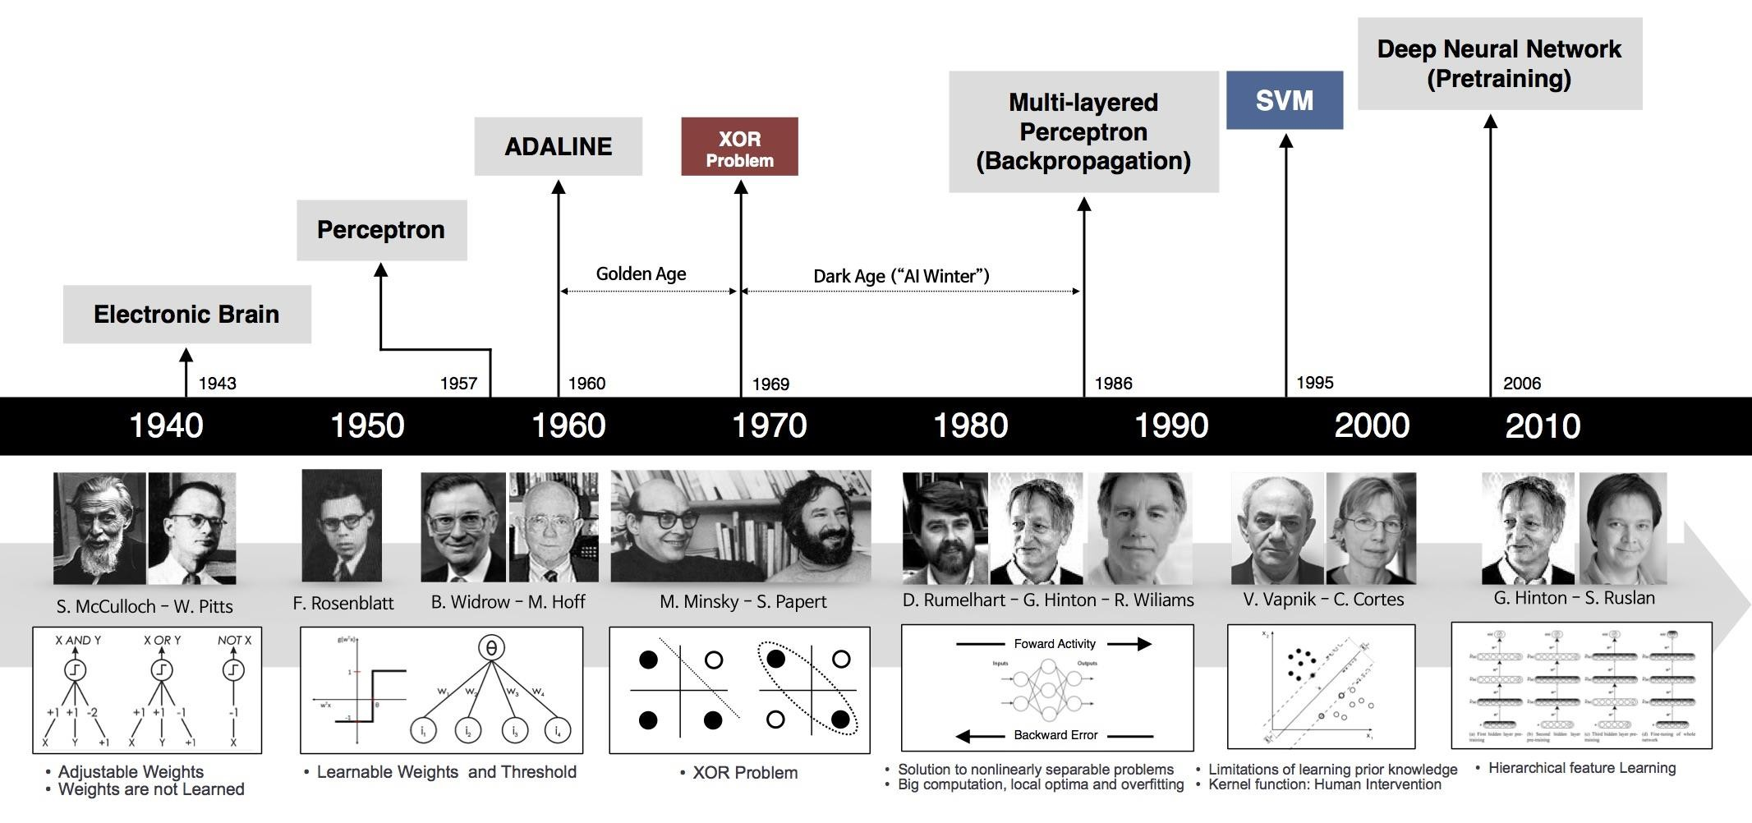
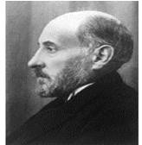
History of ML and Deep Learning
12
1906
Neuron/ Nerve Cell
Ramon y Cajal
Artificial Neuron
Solving Real-Life Problem with Extracted Features
Development of Traditional Machine Learning
Deep Leaning
https://beamandrew.github.io/deeplearning/2017/02/23/deep_learning_101_part1.html

Slide 12
Learning Related to Pattern Recognition

Slide 13
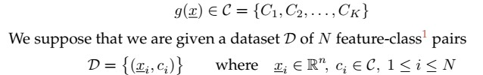
Learning in Pattern Recognition
14
What Does It Mean to Learn?
What does it mean to have learned?
How do we recognize that an algorithm or a method, regardless of
how simple or complex, has succeeded in learning?
The object being learned is a classifier g(x), some sort of black-box / function
/ algorithm / method / concept / system which takes a given feature x and returns the associated class C:

Slide 14


Learning in Pattern Recognition
15
The most primitive type of learning is just memorization, in which case we would consider g() to have learned from the given dataset based on the number of feature- class pairs it successfully reproduces:
In principle, memorization is actually a credible approach to developing a
classifier, however in general there are two significant limitations:
Memorizing is hard : memory concern
Memorizing is not enough: learning is not just to remember
#Generalize is more important
conclusions about
to learning, to
which
be able to reach correct
not seen.
instances
you have

Slide 15
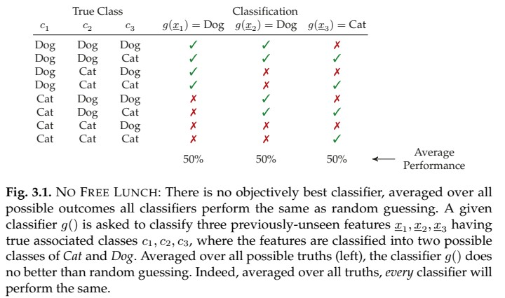
Learning in Pattern Recognition
1
6
Averaged over all possibilities for the unseen data, no classifier generalizes better than any other!

Slide 16
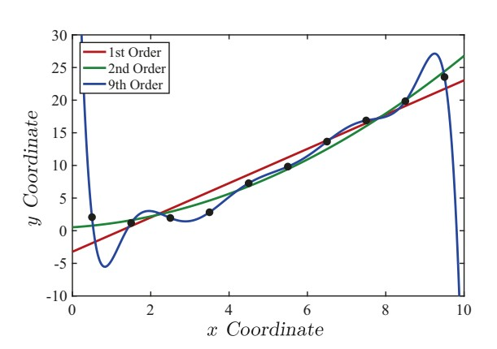
Robustness in Learning
17
Fig. 3.2. What does it mean to fit a model to data? Here we have ten data points
model
(black
dots),
which
come
from
some
unknown
with
added
random noise. We
fit polynomials
to the
points,
for which the
first-order
(linear
regression),
second-order
(parabolic always be polynomial of the data.
regression),
found that
and
ninth-order
fits
p + 1 given
it seems
are shown.
A pth-order polynomial
can
passes
through
points,
so here the ninth-order
fits the points exactly, however
like a very unlikely generalization

Slide 17
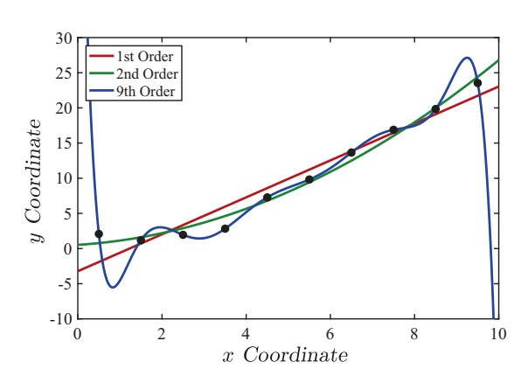
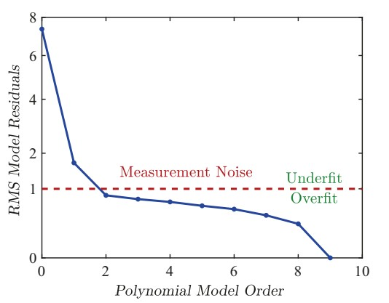
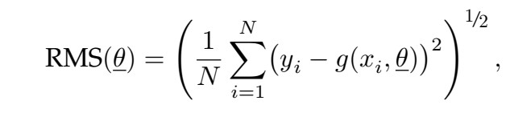
Robustness in Learning
18
Fig. 3.3. Following up on Figure 3.2, we can plot the root-mean-square (RMS) difference between the polynomial fit and the data points, as a function of the polynomial order. In this case the measurement noise level was assumed to have been provided, it was not learned.
In this example the added noise has a standard deviation of σ = 1, meaning that for the correct model, RMS(θexact) = 1. As a result,
Any RMS difference below σ must be overfitting, meaning that g(x; θ) is partly fitting to noise, by taking some of the noise into account when learning θ;
Any RMS difference above σ suggests that the learned model has not adequately generalized, or has not been given adequate flexibility in θ (enough degrees of freedom q) to capture the variations that need to be captured.

Slide 18
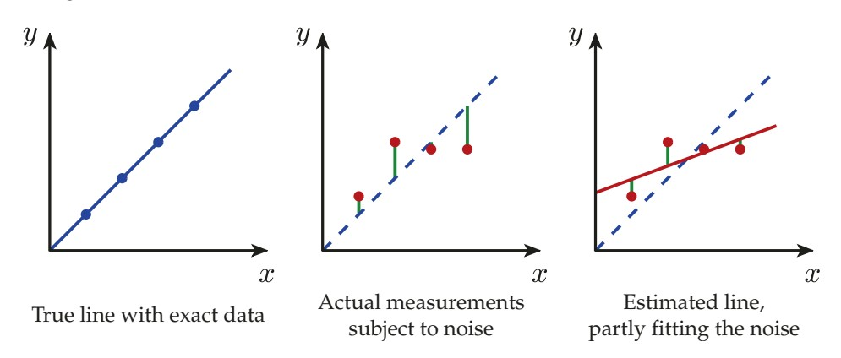
Robustness in Learning
19
Fig. 3.4. Overfitting: Any learning, whether of linear regression (here) or a pattern recognition classifier (Figure 3.5), is said to be overfitting if it begins to tune its parameters to the behaviour of the noise, rather than of the underlying phenomenon we wish to learn. The estimated line (red) is quite plausible, given the four data points (red dots), however it is clear how the line has accommodated (fit) the noise, to make the residuals (green) smaller

Slide 19
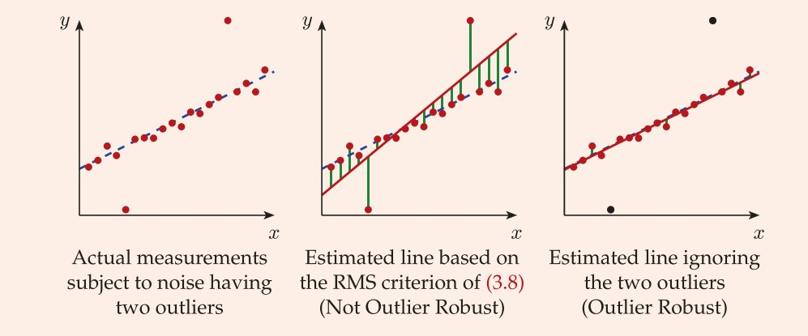
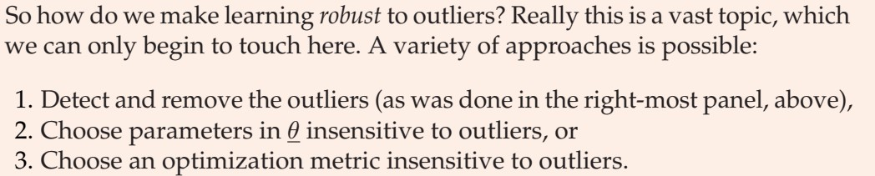
Robustness in Learning
20

Slide 20
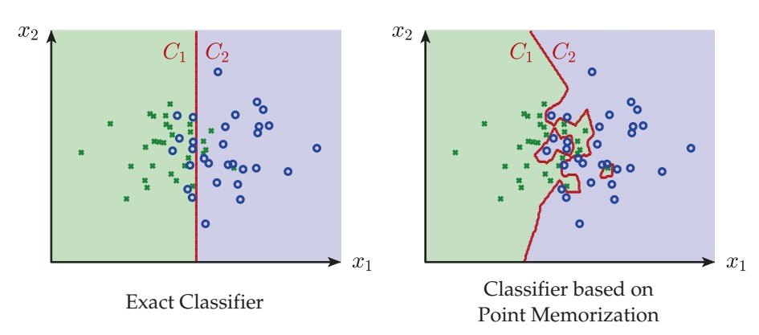
Robustness in Learning
21
Fig. 3.5. OVERFITTING: As in Figure 3.4, but here for a pattern recognition classifier. We will have to wait for Chapter 6 for the details of the classifier to be discussed, however the principle is the same as in regression: Any learning is overfitting if it tunes its parameters to the behaviour of the noise. That tuning is obvious here, in that the memorized classifier (right) is tuning its decision (coloured background) on the basis of individual training points, significantly distracted from the correct or ideal classification (left).

Slide 21
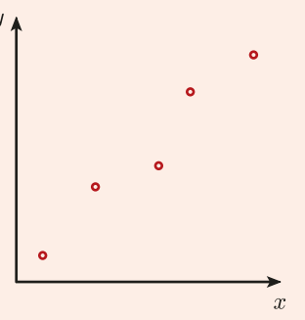
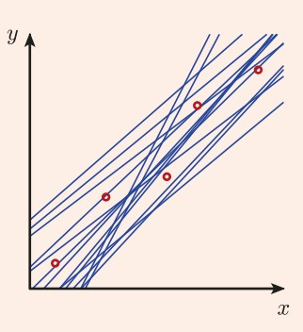
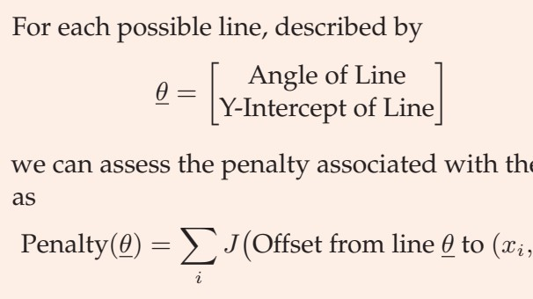
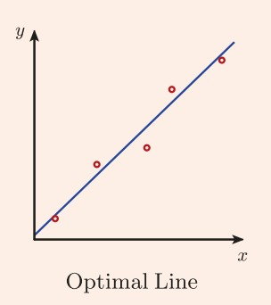
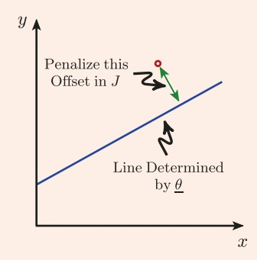
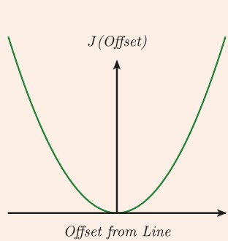
Regression and Classification
22

Slide 22
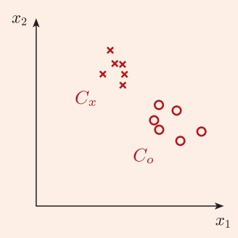
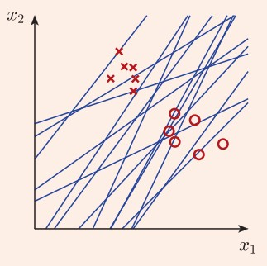
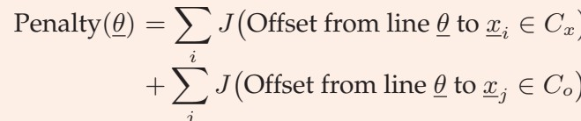
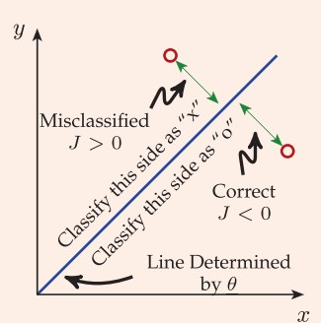
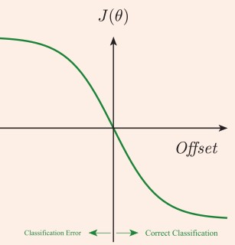
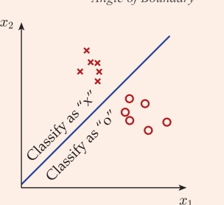
Regression and Classification
23

Slide 23
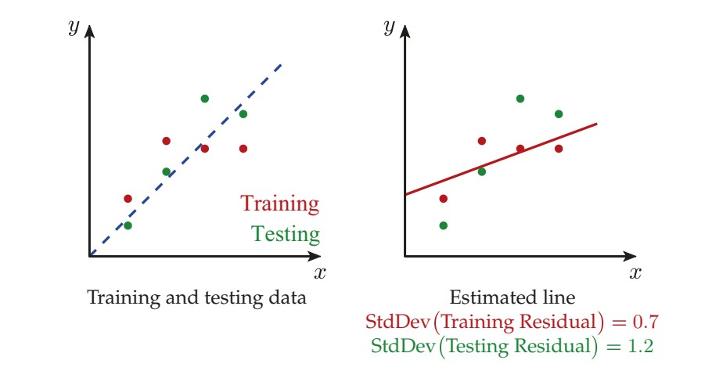
24
Regression and Classification
Fig. 3.7. We have separate training and testing data (left), such that the learned model (red line) is deduced from the training data, but assessed against the testing data. Observe the degree to which the estimated line fits to the noise, based on the difference between the fit to training data (overfit, under-reporting model inconsistency) and the fit to testing data (which is an accurate, objective assessment).

Slide 24
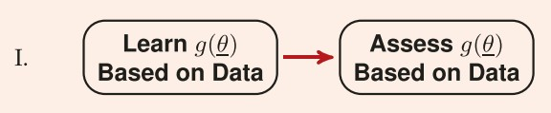
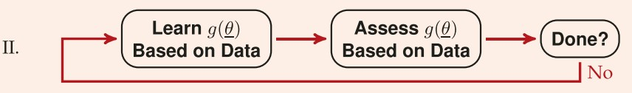
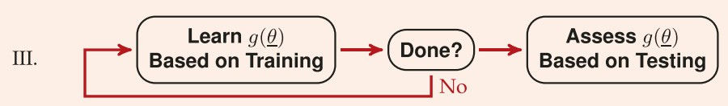
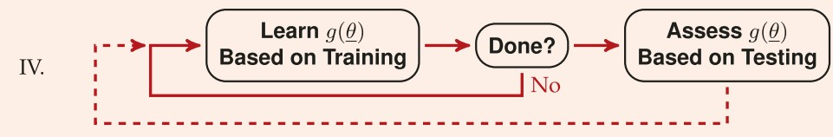
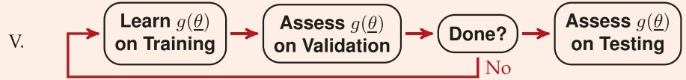
Use of Data in Learning
25

Slide 25
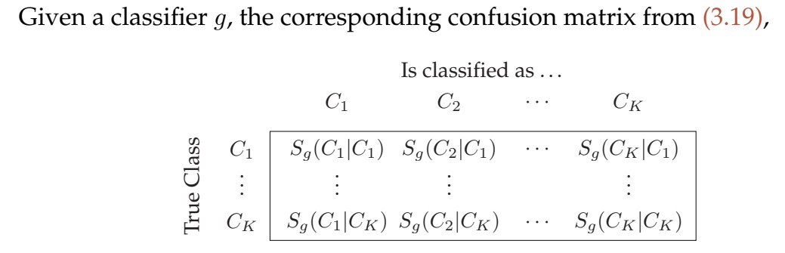
Classifier Evaluation / Performance Measure
26
Test Set Accuracy
Test Set Error Rate
Confusion Matrix

Slide 26
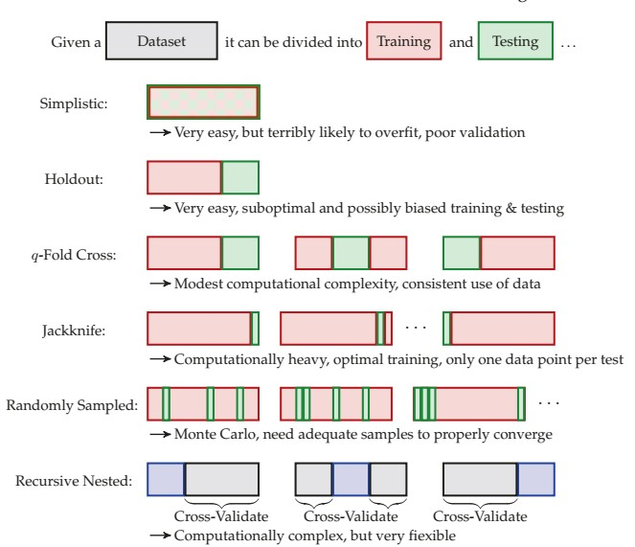
Classifier Validation
27

Slide 27
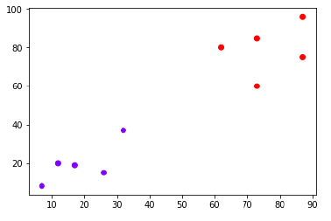
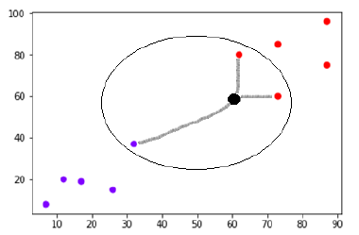
K-nearest neighbors (KNN) Classifier
28
Lazy learning algorithm − KNN is a lazy learning algorithm because it does not have a specialized training phase and uses all the data for training while classification.
Non-parametric learning algorithm − KNN is also a non-parametric learning algorithm because it doesn’t assume anything about the underlying data.
https://www.tutorialspoint.com/machine_learning_with_python/machine_learning_with_pyt hon_knn_algorithm_finding_nearest_neighbors.htm

Slide 28
K-nearest neighbors (KNN) Classifier
29
- The Simplest Classifier

Slide 29
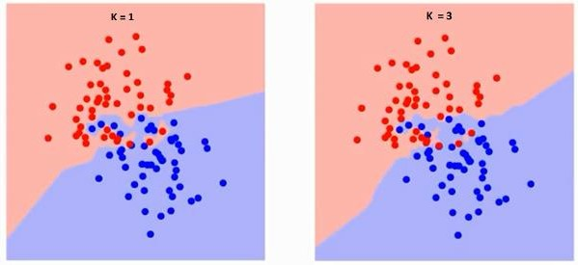
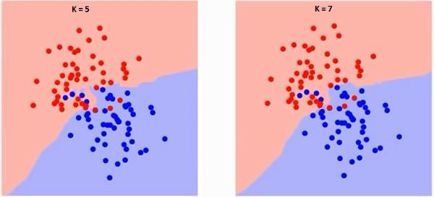
K-nearest neighbors (KNN) Classifier
0
3
The boundary becomes smoother with increasing value of K.
With K increasing to infinity it finally becomes all blue or all red depending on the total majority.
https://www.analyticsvidhya.com/blog/2018/03/introduction-k-neighbours-algorithm- clustering/#h-what-is-knn-k-nearest-neighbor-algorithm

Slide 30



K-nearest neighbors (KNN) Classifier
1
3
KNN
Pros of
Very simple algorithm to understand and interpret.
Very useful for nonlinear data because there is no assumption about data in this
algorithm.
Versatile algorithm as we can use it for classification as well as regression.
High accuracy but there are much better supervised learning models than KNN.
Cons of KNN
Computationally a bit expensive algorithm because it stores all the training data.
High memory storage required as compared to other supervised algorithms.
Prediction is slow in case of big N.
Very sensitive to the scale of data as well as irrelevant features.
learning
Applications of KNN
Banking System: to predict weather an individual is fit for loan approval? Does that individual have the characteristics similar to the defaulters one?
Calculating Credit Ratings: can be used to find an individual’s credit rating by comparing with the persons having similar traits.
Other areas in which KNN algorithm can be used are Speech Recognition, Handwriting
Detection, Image Recognition and Video Recognition.

Slide 31
32
Thanks for your attention
Question and Answer

